Slide 1

AI Engineer Agentic Track
The Complete
Agent & MCP
Course
Week 4
Day 3

Slide 2
Week 6: MCP
Agentic
Architecture
and MCP
Building an
MCP Server
and Client
Multiple Local
and Remote
MCP servers
Project 8: AI
Equity Traders
Project 8: AI
Equity Traders
In Action
Week 5: Agent Frameworks
Google ADK and A2A
AWS Strands Agents
Other Python Frameworks
JS/TS Frameworks
Project 7:
Agent
Loop
Week 4: LangGraph
LangChain Core
LangGraph
LangChain
create_agent
Deep Agents
Project 6:
Sidekick
Week 3: CrewAI
Understand
Crew AI
Concepts
Build a Crew
Agent
Project 4: Stock
Picker
Project 5:
Developer
Agent
Project 5:
Engineering
Team
Week 2: OpenAI Agents SDK
Understand
OpenAI Agents
SDK concepts
Project 2: an
SDR
Tools vs Agents
Guardrails
Project 3: Deep
Research
Project 3: Deep
Research app
Week 1: Foundations
Make an
Agentic
Workflow
Agents and
Agentic
Patterns
Orchestrating
LLMs
Autonomy and
Tools
Project 1:
Your personal
career agent

Slide 3
Recap: the abstraction layers
Four levels: control at the bottom, convenience at the top
Layer 4 Harness
Planning, sub agents, a filesystem; you supply intent
deepagents
Layer 3 Agent
The agent loop prebuilt; you supply model, tools and prompt
langchain
TODAY
Layer 2 Orchestration
StateGraph, nodes, edges, checkpoints; you control the flow
langgraph
Layer 1 Building blocks
Models, messages and tools; you control everything
langchain-core

Slide 4
create_agent
Layer 3: the agent loop in one function call
One call a model, tools and a system prompt; the agent loop arrives prebuilt
A LangGraph graph it returns the same compiled graph you wired by hand yesterday
The trade-offs climb a layer: hand control to the framework, write far less code
Batteries included memory, structured output, middleware and MCP, ready for projects

Slide 5







Features we'll explore
The simplest agent a model and a prompt in one call, like OpenAI Agents SDK
ainvoke invoke's async equivalent; await it, nothing else changes
Tools your @tool functions from Day 1; the loop runs itself
Memory a checkpointer and a thread_id, exactly like yesterday
Structured output response_format returns your Pydantic object
Middleware your hooks inside the loop
MCP server tools drive a real browser before your eyes

Slide 6
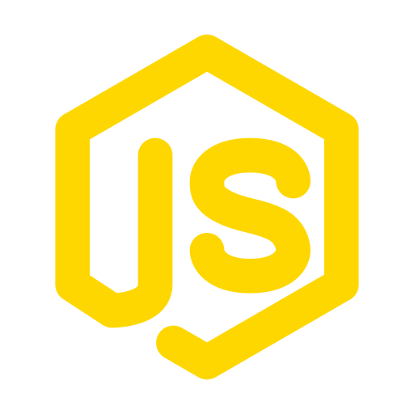

Setup: Node and Playwright
What Part 6 needs from your machine
Node.js the JavaScript runtime; its npx command runs packages on demand
Install once the LTS from nodejs.org, then confirm with node --version
Playwright Microsoft's browser automation; it opens and drives real Chrome
Nothing to install npx fetches the MCP server on first run
Preflight we screenshot a live page before any agent touches it

Slide 7
Week 6: MCP
Agentic
Architecture
and MCP
Building an
MCP Server
and Client
Multiple Local
and Remote
MCP servers
Project 8: AI
Equity Traders
Project 8: AI
Equity Traders
In Action
Week 5: Agent Frameworks
Google ADK and A2A
AWS Strands Agents
Other Python Frameworks
JS/TS Frameworks
Project 7:
Agent
Loop
Week 4: LangGraph
LangChain Core
LangGraph
LangChain
create_agent
Deep Agents
Project 6:
Sidekick
Week 3: CrewAI
Understand
Crew AI
Concepts
Build a Crew
Agent
Project 4: Stock
Picker
Project 5:
Developer
Agent
Project 5:
Engineering
Team
Week 2: OpenAI Agents SDK
Understand
OpenAI Agents
SDK concepts
Project 2: an
SDR
Tools vs Agents
Guardrails
Project 3: Deep
Research
Project 3: Deep
Research app
Week 1: Foundations
Make an
Agentic
Workflow
Agents and
Agentic
Patterns
Orchestrating
LLMs
Autonomy and
Tools
Project 1:
Your personal
career agent

Slide 8

AI Engineer Agentic Track
The Complete
Agent & MCP
Course
60%
Complete

